Slide 1
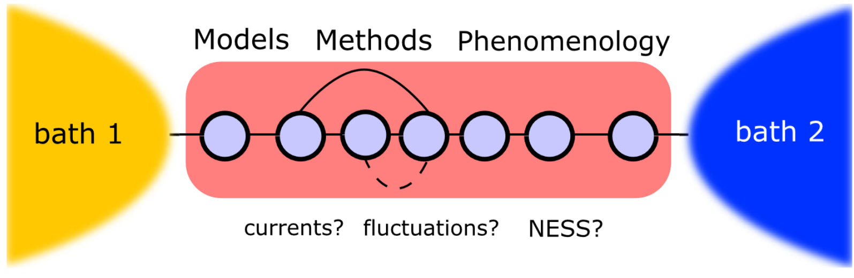
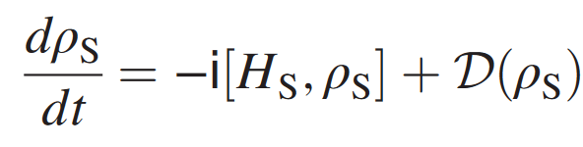

Boundary-driven Open Quantum Systems
Joaquin Peñuela Parra
MSE 2040 -University of Pittsburgh
Notes:
Boundary-driven systems are quantum systems coupled, at their edges, to different baths.

Slide 2
Table of contents
01
Introduction
02
Transport Properties
03
Simulation
04
Summary
Paradigm of Open Quantum System Dynamics
Continuity Equations
Rectification
Notes:
1:00

Slide 3
01
Introduction
Notes:
A piece of material placed in contact with two baths at different temperatures can reach a nonequilibrium steady state (NESS) characterized by a current of heat from one bath to the other. This corresponds to the simplest scenario of nonequilibrium systems most of us are aware of. The currents are generated by differences in the baths, and the type of current that emerges depends on the properties of the bath, of the system, and of their coupling.

Slide 4
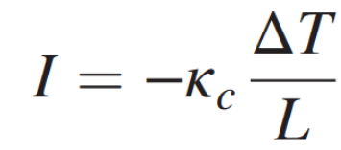

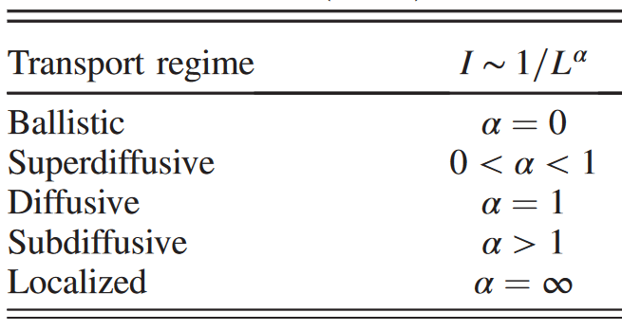

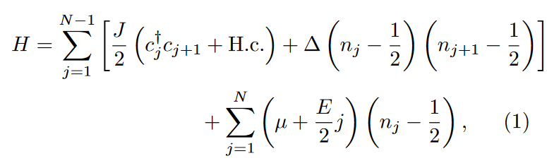
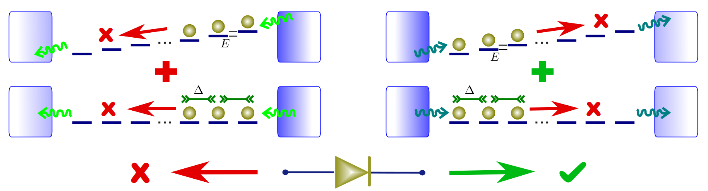

Fourier’s Law (1822)
Diffusive transport.
Conductivity(T,L) ⇒ non-linear dependence of I with temperature
⇒ Rectification.
Notes:
4:00
To give an idea of the problems which will be reviewed, we briefly consider heat transport between two baths at different temperatures through a bulk material. It was found by Fourier (Fourier, 1822), that the heat current I depends on the length of the material.
However, digging deeper one finds that transport can be a much richer field. First of all, the conductivity is actually a function of both the temperature T and system size L. In fact, there is a non-linear dependence of the current with temperature. The ability to control this non-linear dependence can result in devices such as diodes, transistors, and energy converters.

Slide 5
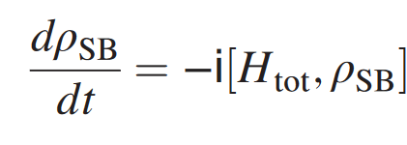


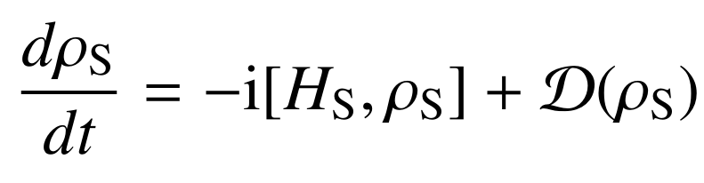
Open Quantum Systems
Liouville von Neumann Equation:
with
Main goal:
Quantum Master Equations (QMEs):
Notes:
5:30
In standard treatments it is assumed that the global density matrix of the system and its surrounding baths evolves unitarily, according to the Liouville von Neumann equation.
The last term, usually called the dissipator, is a linear superoperator that takes into account the effects of the reservoir.

Slide 6
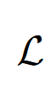
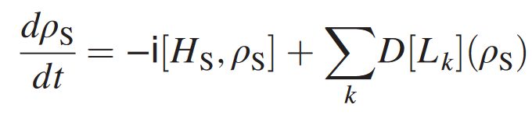
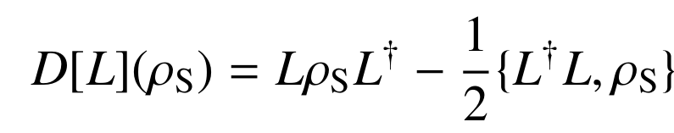


Quantum Master Equations (QMEs):
where
with
Dynamics will be completely positive and trace preserving (CPTP).
Nonequilibrium steady states (NESSs)
⇒
Current independent of the site. Which current?
Notes:
7:00
is called a Lindblad dissipator with jump operators L.

Slide 7
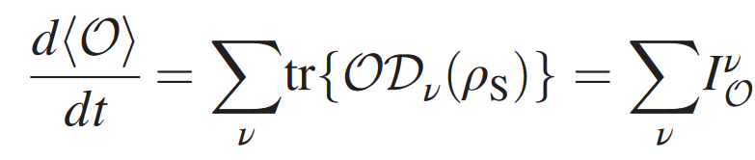
02
Transport Properties

Slide 8

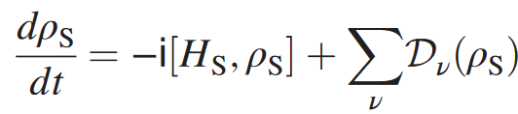
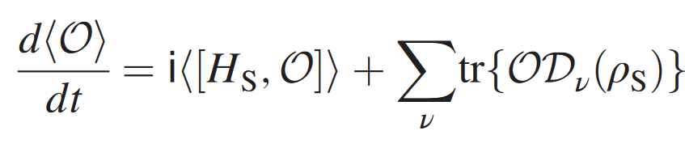

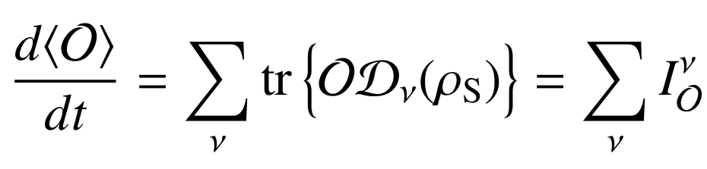

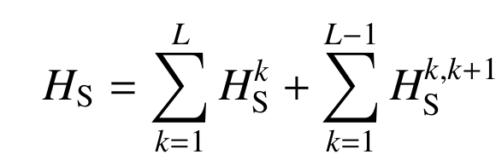



Consider an arbitrary global operator:
⇒
Transport if and only if
Consider a local operator:
⇒
Locally conserved:
Notes:
8:30

Slide 9
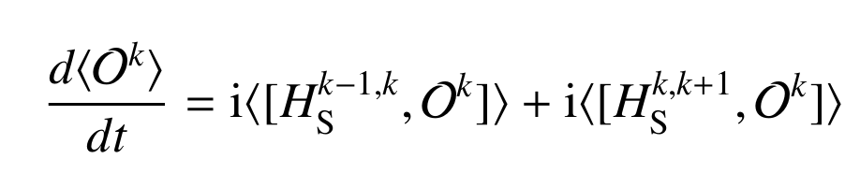



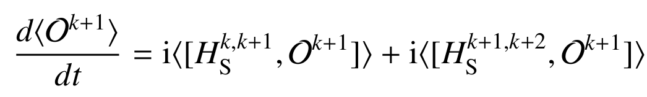

⇒
(without dissipation)
Flow from site k-1?
⇒ No.
Flow from site k+1?
The quantity leaving k to k+1 is not necessarily the same as that entering k+1 from k.
Transport if and only if
Is the Flow from site k-1 and
the Flow from site k+1.
Notes:
10:00

Slide 10
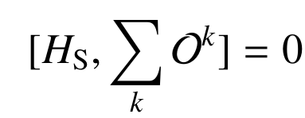





Transport:
and
Similar as we see for global operators:
We can define a current leaving k to k+1:
(The flow from last slide)
With:
Notes:
11:30

Slide 11
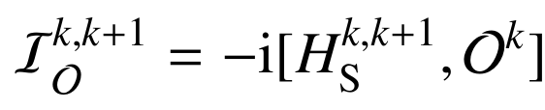
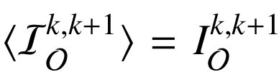


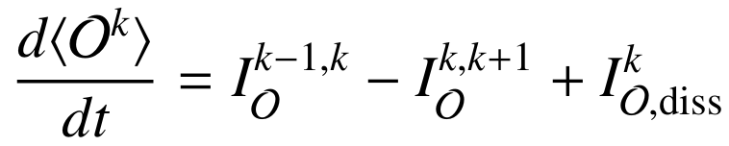
Current leaving k to k+1:
⇒
Now, with dissipations.
Defining
⇒
Notes:
13:00

Slide 12
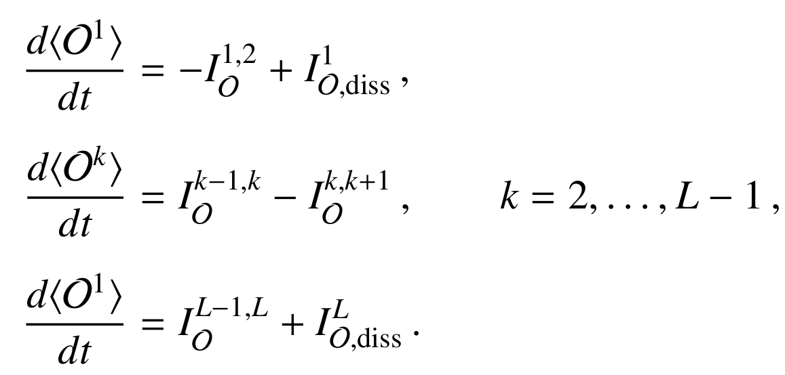


As
⇒
In the steady state
⇒
Notes:
14:00

Slide 13

03
Simulation

Slide 14

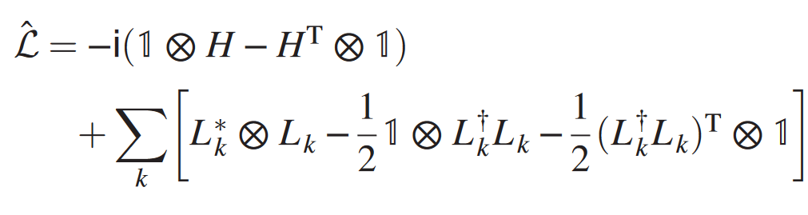
How determine the steady state?
Vectorization results in this a matrix
We can solve the steady state using this:
Notes:
15:00

Slide 15
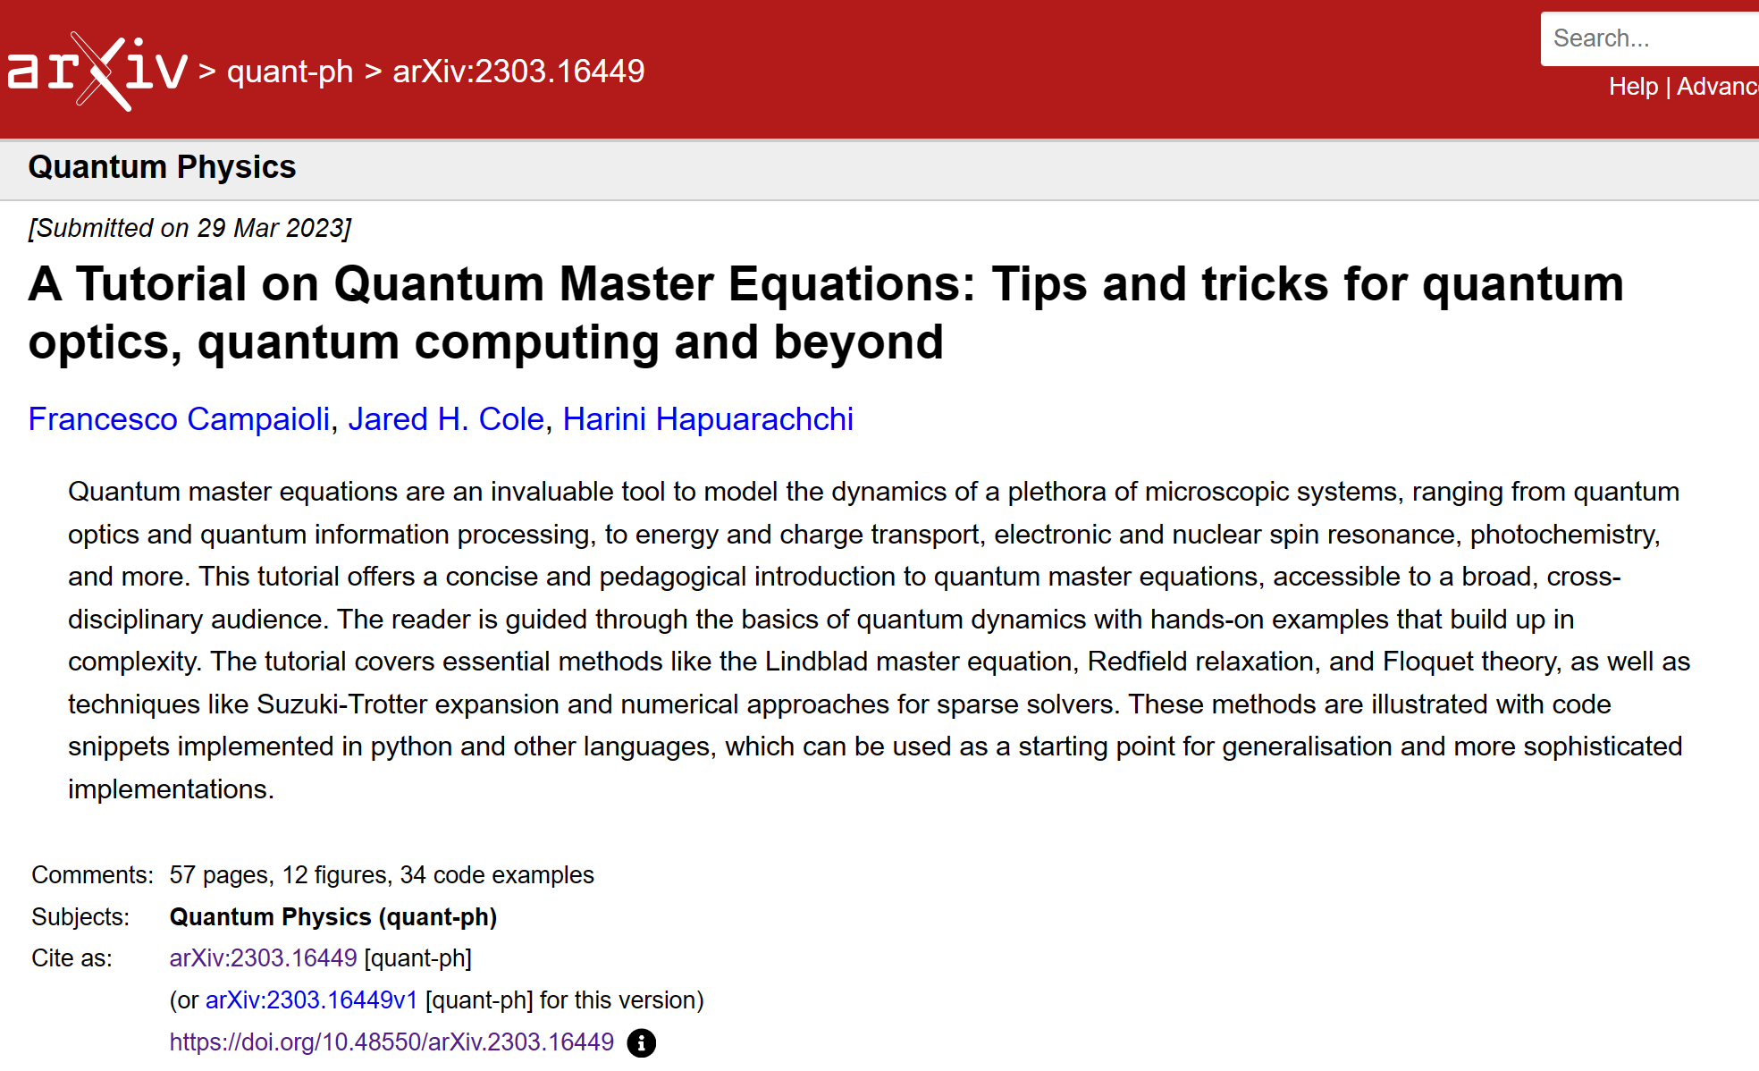

Slide 16
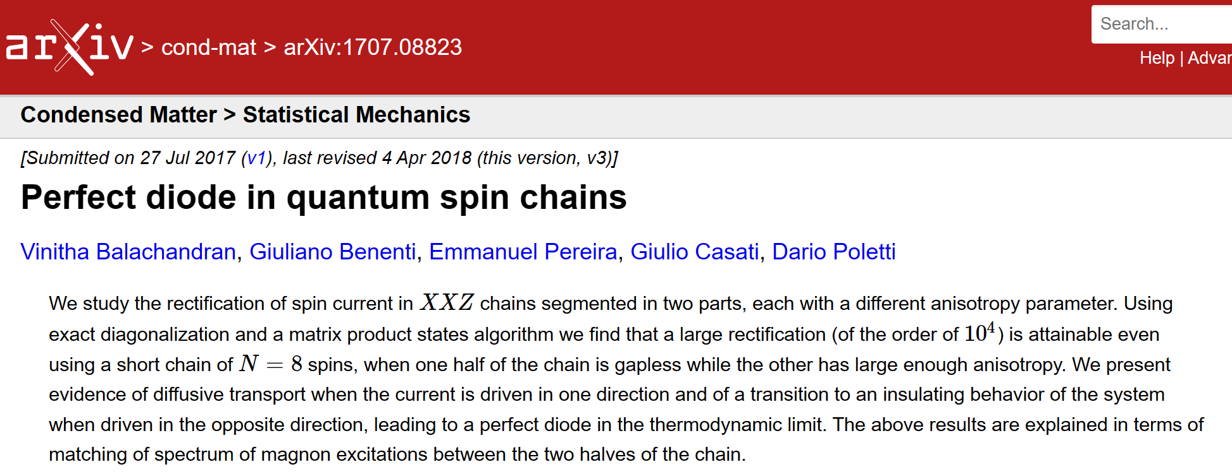
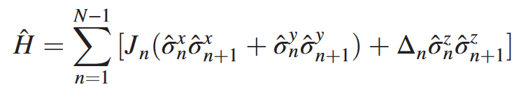
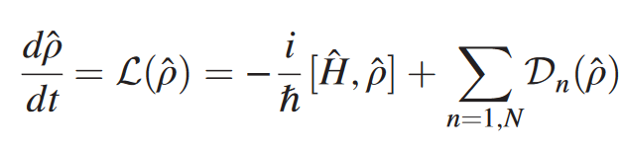
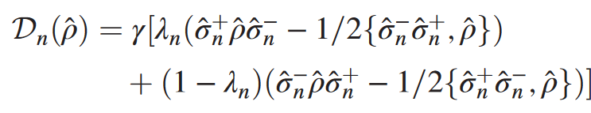



→
with
⇒ on one side of the chain, the bath tends to set the spins to be pointing down:
for
or to be in an equal mixture of up and down spins
for
Notes:
16:00

Slide 17




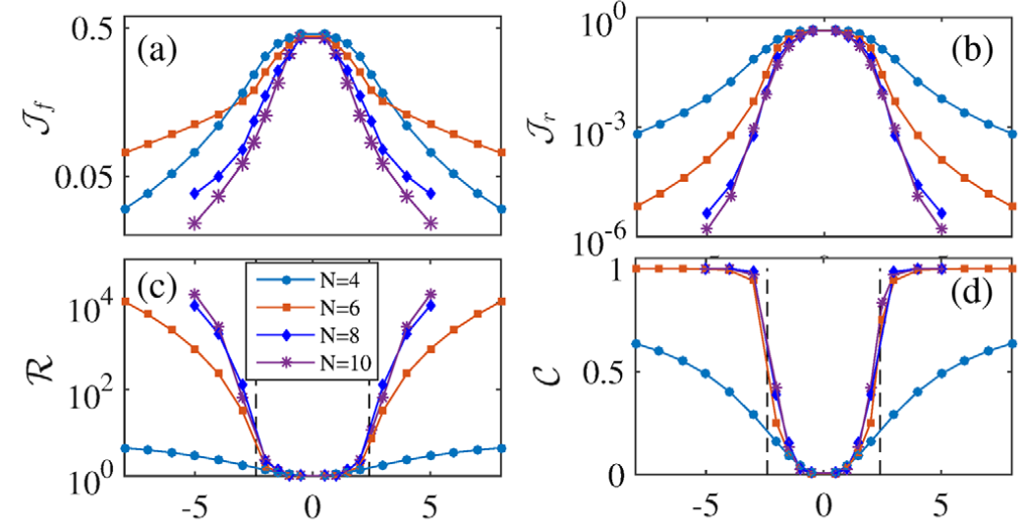
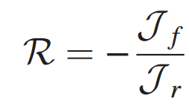
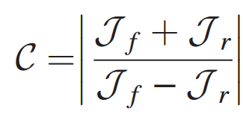
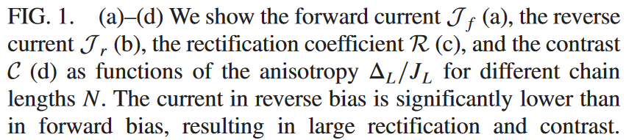
“forward bias” the spin current flows from left to right.
“reverse bias” the spin current flows from right to left.
⇒

Slide 18
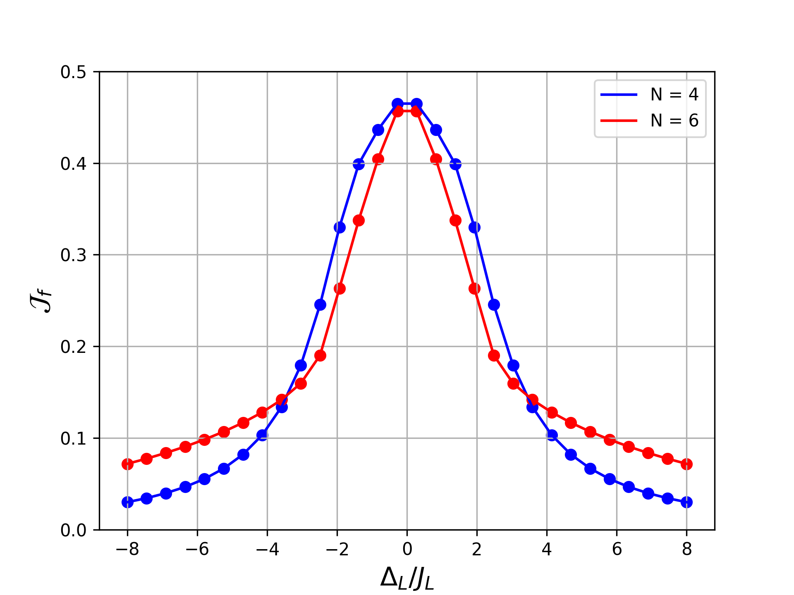
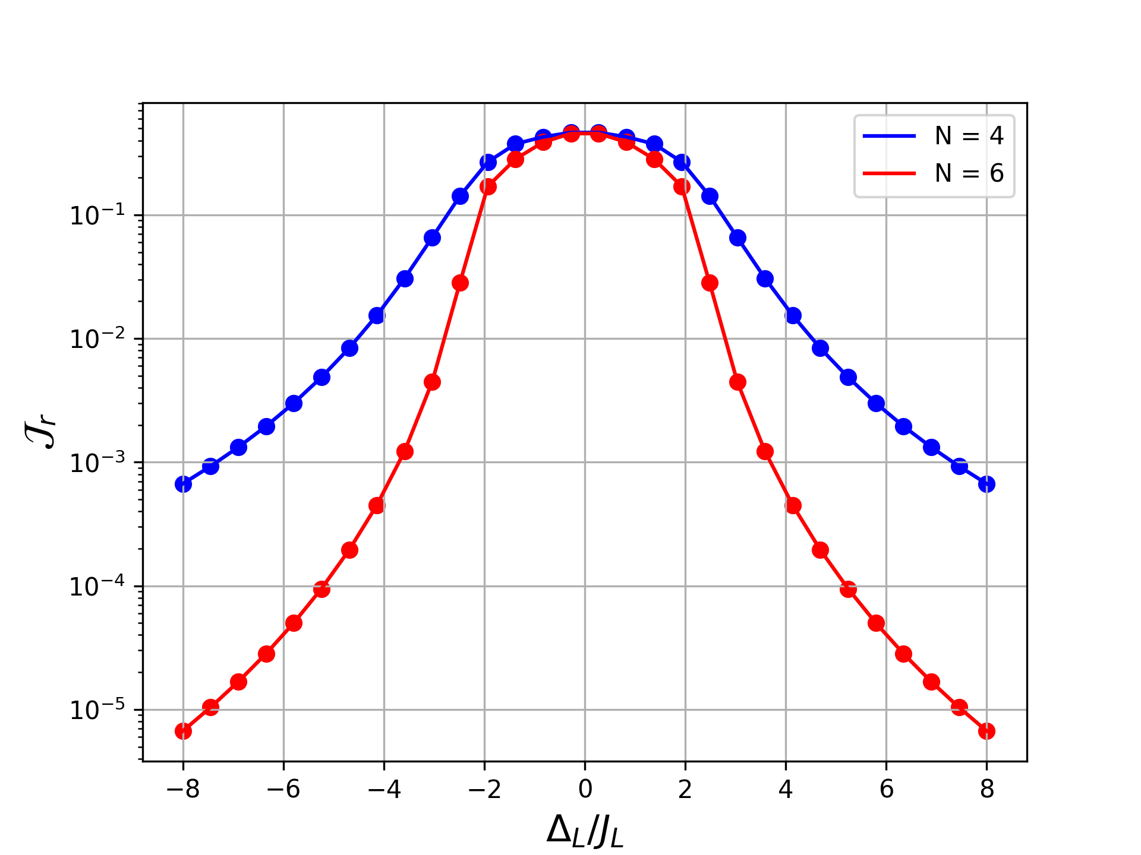
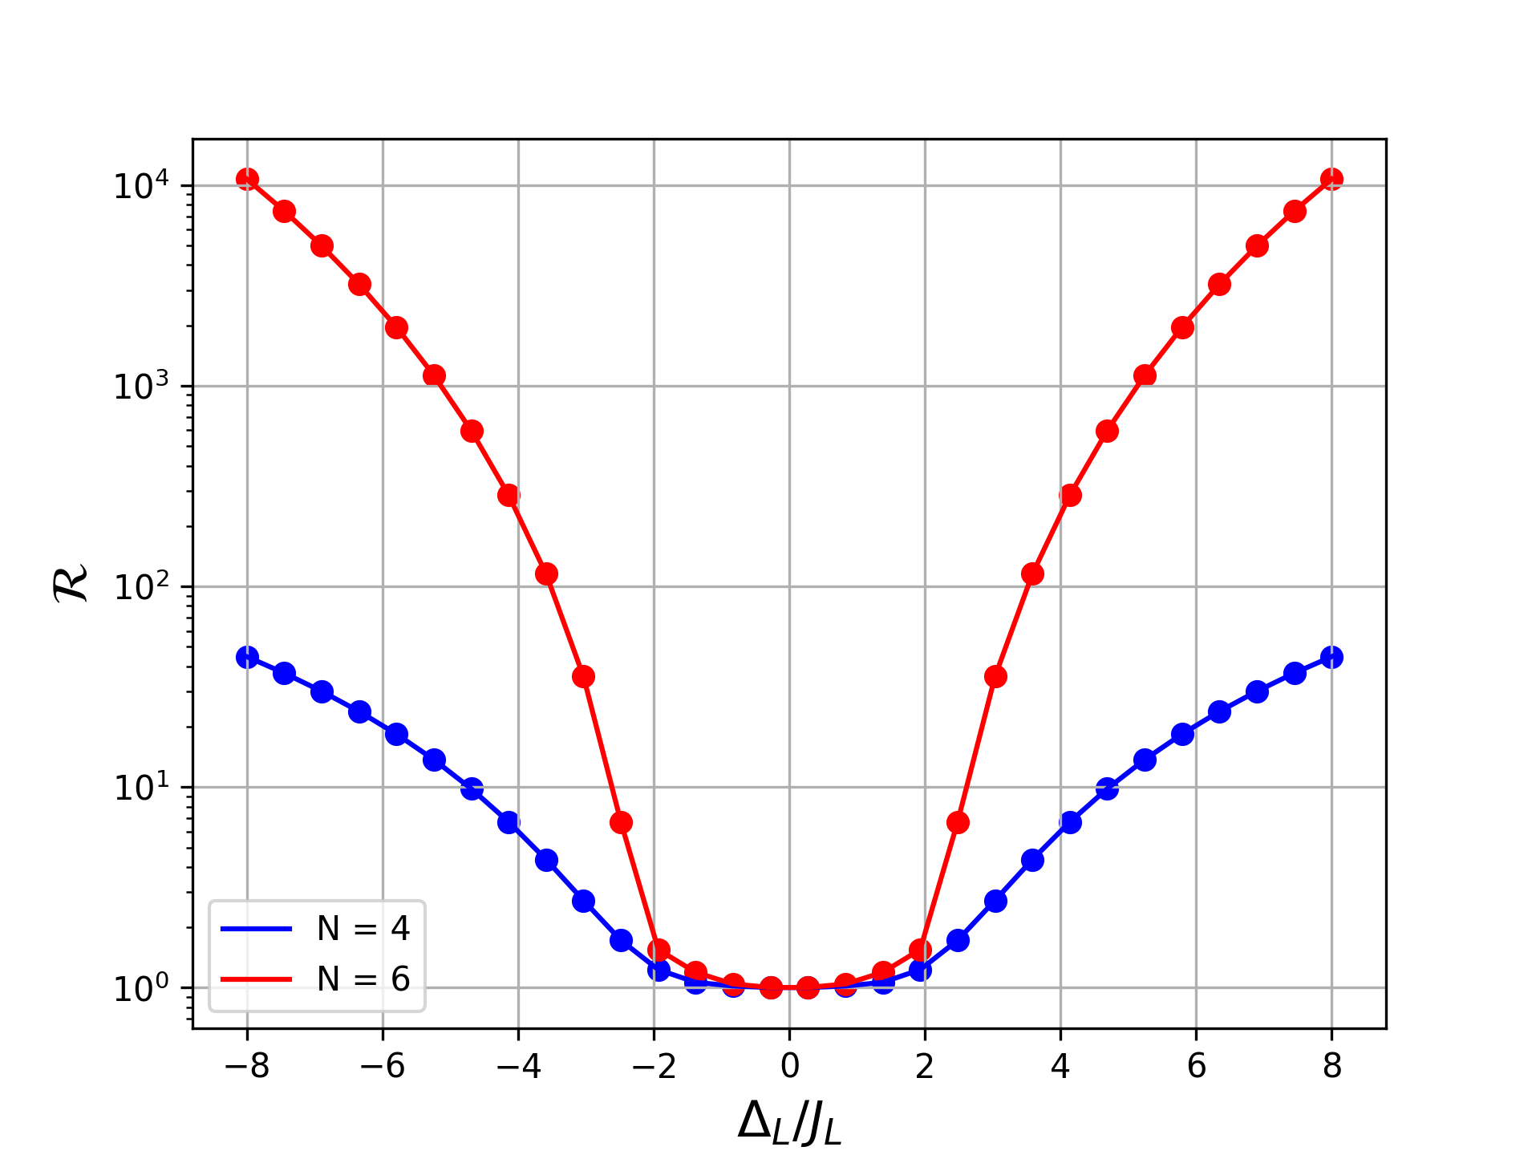
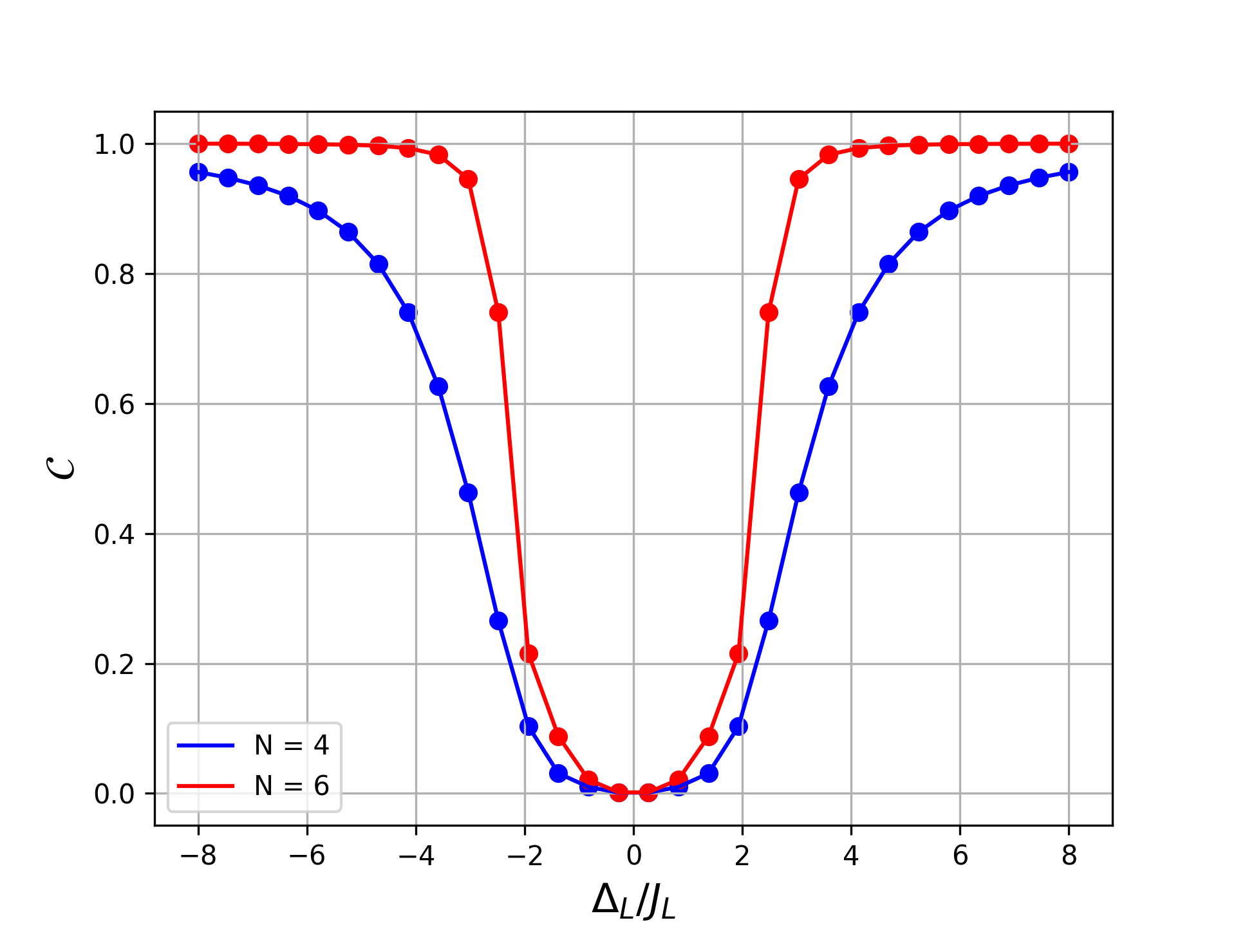
Notes:
18:00

Slide 19
04
Summary

Slide 20
Open Quantum Systems:
Main goal:
Quantum Master Equations (QMEs):
with
Transport Properties:
In the steady state
⇒
Notes:
In standard treatments it is assumed that the global density matrix of the system and its surrounding baths evolves unitarily, according to the Liouville von Neumann equation.
The last term, usually called the dissipator, is a linear superoperator that takes into account the effects of the reservoir.

Slide 21
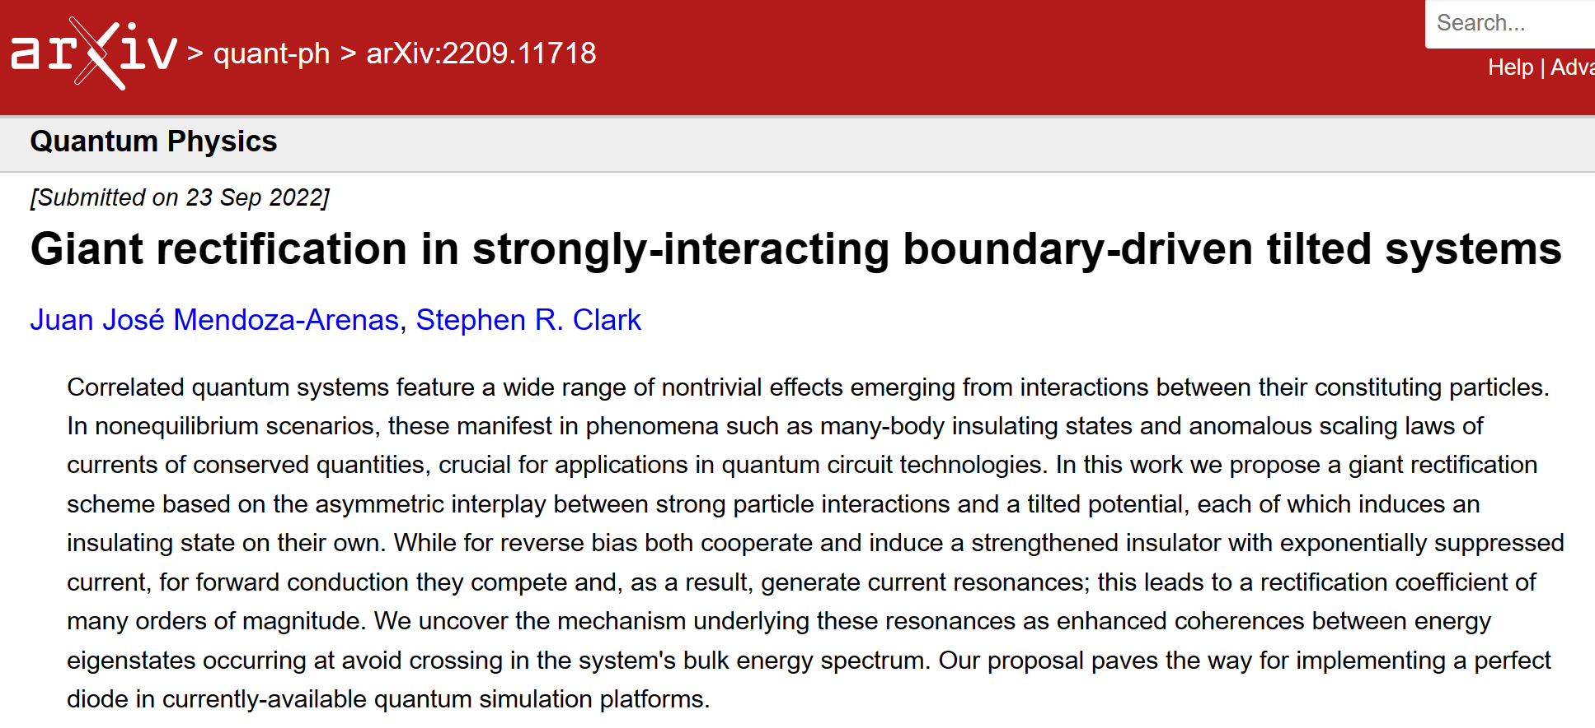
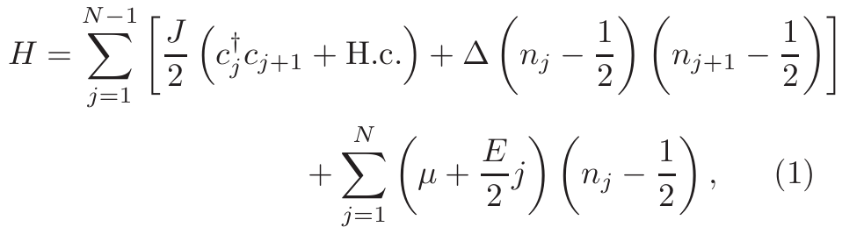

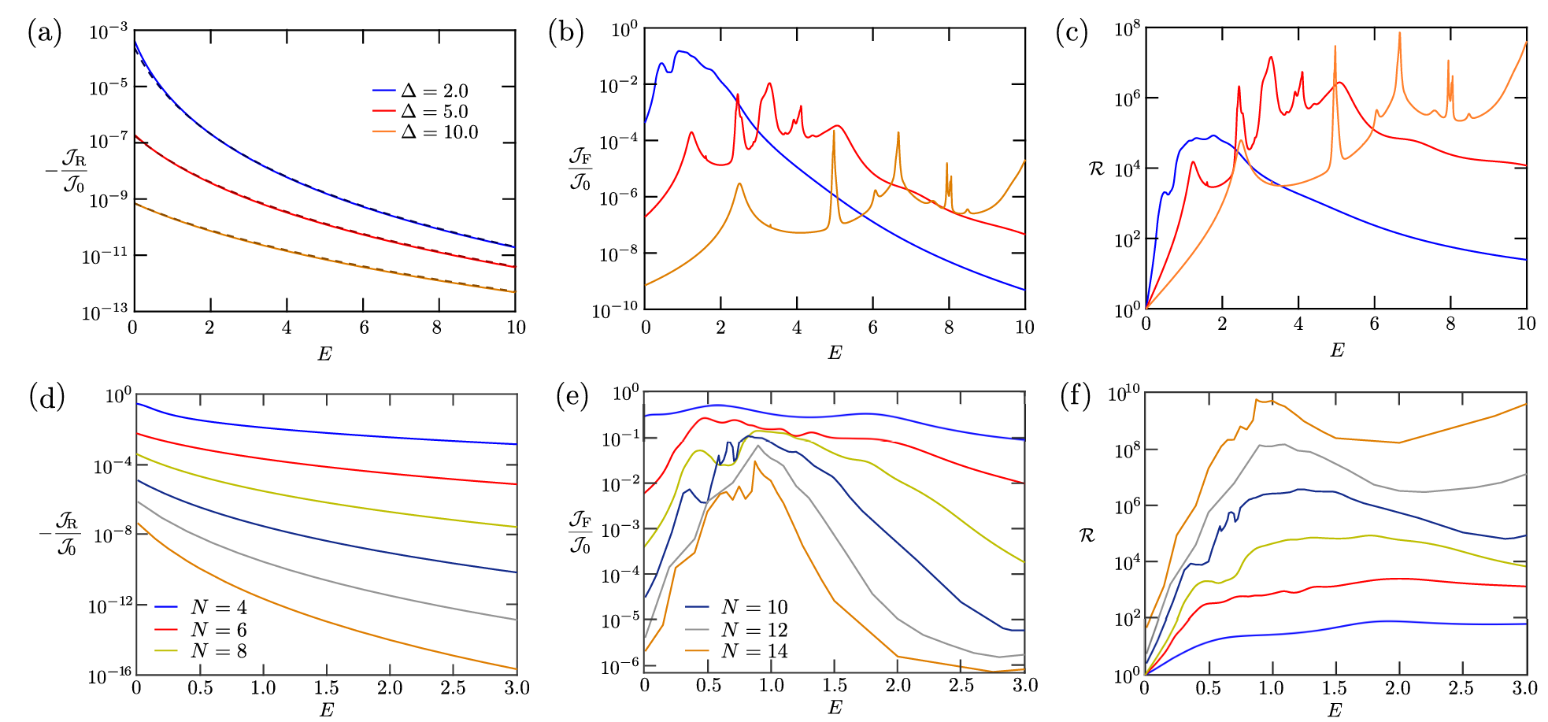
⇒
Notes:
Experimentally, commercial electronic semiconductor diodes have demonstrated a ratio of forward and backward currents (or rectification coefficient) of ≈ 10^5 − 10^8. In this article, they found Specifically that R can exceed coefficients of 10^9 in small systems (that have been implemented experimentally in several quantum simulation platforms) with no need of fine tuning and even with moderate interactions.

Slide 22
References
[1] Landi, G. T., Poletti, D., & Schaller, G. (2022). Nonequilibrium boundary-driven quantum systems: Models, methods, and properties. Reviews of Modern Physics, 94(4), 045006.
[2] Campaioli, F., Cole, J. H., & Hapuarachchi, H. (2023). A Tutorial on Quantum Master Equations: Tips and tricks for quantum optics, quantum computing and beyond. arXiv preprint arXiv:2303.16449.
[3] Balachandran, V., Benenti, G., Pereira, E., Casati, G., & Poletti, D. (2018). Perfect diode in quantum spin chains. Physical review letters, 120(20), 200603.
[4] Mendoza-Arenas, J. J., & Clark, S. R. (2022). Giant rectification in strongly-interacting boundary-driven tilted systems. arXiv preprint arXiv:2209.11718.

